Slide 1
Best Practices in Ending Homelessness

Slide 2
Introduction
Sean Glennon - Community Development Director, Quincy, MA
City of Quincy is the Collaborative Applicant for the MA-511 CoC
Formally known as the Quincy, Brockton, Weymouth, Plymouth City and County Continuum of Care (aka South Shore CoC)
Consists of 29 communities in southeastern MA (after 2015 merger)
3rd largest CoC in MA ($11M for 12 projects – 420 units of PSH); and 7th largest in Region 1
SouthShoreCoC.org (Emergency Resources; Housing & Social Services; Safety Resources; About Us – Nuts & Bolts / CE / CoC Flowchart)

Slide 4
Not just CoC…
CDBG: Acquisition of land
ESG: Prevention / Rapid Re-Housing / Emergency Shelter
HOME / HOME-ARP: Rental Housing / TBRA / Non-Congregate Shelter
HOPWA
Leveraging

Slide 5
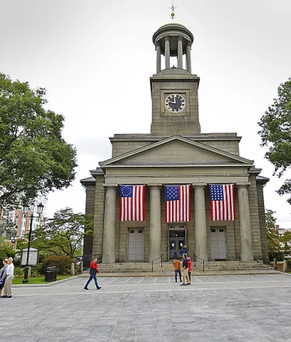
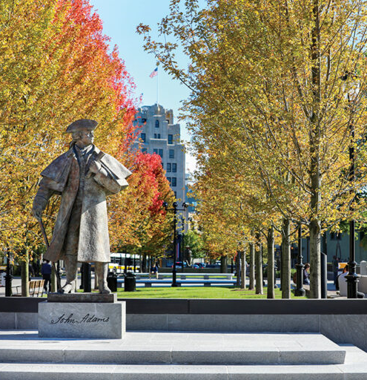
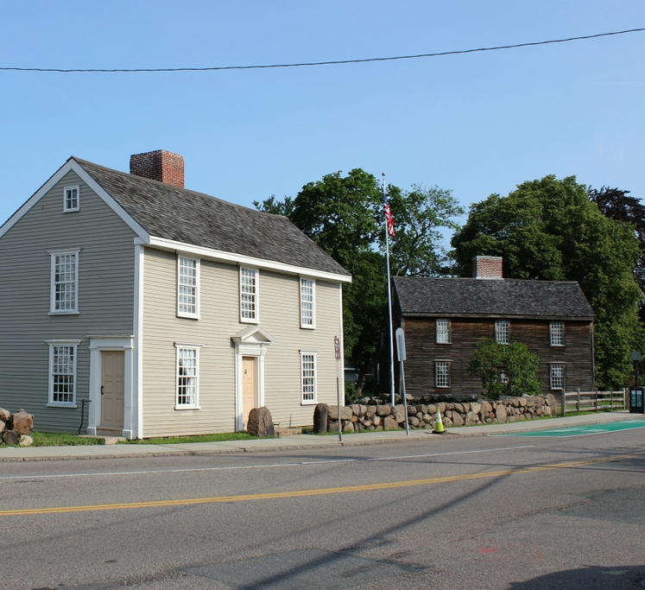
Quincy Facts
Population: 101,000
“City of Presidents” - John Adams & JQA
Location of “Old House” at “Peacefield”
Birthplace of John Hancock

Slide 6
Quincy Success Stories
10 Year Plan to End Chronic Homelessness
Yawkey Housing Resource Center
• 99-yr lease from city ($2.3M)
• $1M from AHTF
• $90,000 annually in ESG

Slide 7
Panel
April Connolly - Chief of Programs, Pine Street Inn
Liz Rogers - Chief Strategy Officer, Father Bill's & MainSpring
Tony Milner – Director, Housing Stability Division of the Salt Lake City Corporation

Slide 8
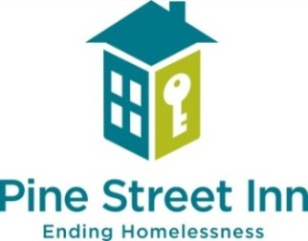
Pine Street Inn
April Connolly, LICSW
Chief of Programs

Slide 9
Housing Environment Restricted by High Cost-Burden, Shortage, Low Vacancy Rate, & Economic Inequality
Cost Burden: High-cost burden, locally and regionally, has increased over time and disproportionately impacts Black, Indigenous, and People of Color (BIPOC) communities due to structural racism.
Shortage of Low-Cost Housing: High incidence of cost burdens among lower-income renters is largely due to the shortage of low-cost housing.
Vacancy Rates: Remain incredibly low across Greater Boston, which makes it challenges to find a suitable, affordable housing option.
$86,613
Annual income needed to afford a one-bedroom rental home at HUD’s Fair Market Rent in MA
-170,810
Shortage of rental homes affordable and available to Extremely Low Income (ELI) renters in MA
2.5%
Rental Vacancy Rate in Massachusetts in 2024—well below a healthy rate of 6%
Notes:
Note that the vacancy rate has decreased since April 2023 (it was 4.2%), demonstrating an even more restricted housing landscape
Definitions:
AMI = Area Median Income: calculated by HUD, the mid-point of a specific’s areas income distribution
ELI = whose incomes are at or below the poverty guideline or 30% of their area median income (AMI).
Sources:
1) The Boston Foundation, Chapter 1: Economic Inequality and Cost Burden – TBF
2) NLIHC, Housing Needs by State: Massachusetts
3) Housing Boston 2030, Annual Report 2020 (boston.gov)

Slide 10
Homelessness in Boston, 2008-2023
After a downward trend, homelessness again on the rise
Source: City of Boston annual point-in-time homeless census, available at Boston.org.
Notes:
Similar to national and state trends, we are seeing increases in unsheltered and sheltered homelessness in Boston.
Trend of decline in homeless census from 2016 to 2022 for both street and shelter counts.
Rise in unsheltered homelessness in 2020 and 2021 is likely due in part to effects of the COVID-19 pandemic.
Decrease in street count by 30% (51 individuals) from 2021 to 2022; then increase by 42% from 2022 – 2023
In the one-year period from 2022–2023, homelessness in America for individuals increased 11%; in MA the increase was 12%.
In Boston it was an overall increase 17%; and for people who were unsheltered, a startling 42% increase.
Boston still has one of the smallest percentages of unsheltered people experiencing homelessness of all major US cities.

Slide 11
Census Over Time: Men’s Inn
Notes:
We have maintained census at or near capacity for past 4 years even with decrease in beds; however this has changed in recent months.
Capacity is a monthly average and includes additional temporary beds.

Slide 12
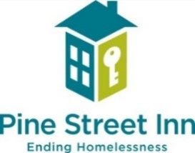
Pine Street Inn
Emergency Shelter and Street Outreach: We provide safe refuge to more than 400 people each night within four emergency shelters. On the street, outreach teams provide life-saving food, blankets, human contact, and access to shelter and housing.
Coordinated Housing Solutions: Our Housing Resource Coordinators meet with shelter guests to navigate paths to housing, within or beyond PSI. We offer solutions such as Rapid Rehousing. We also prevent homelessness through problem-solving by phone and in person.
Supportive Housing: This growing program formerly homeless individuals who live in buildings we own or operate as well as in rental apartments, with a current total of 960 units. We follow the research-proven Housing First approach, combining housing with on-site supportive services to help tenants achieve their highest level of independence.
Workforce Development: This program serves about 160 people each year, providing training for careers in food services and housekeeping, with training embedded within our iCater social enterprise.

Slide 13
Unsheltered
Individual unsheltered homelessness in Boston increased 42% from 2022 to 2023
Continued increased vulnerability and psychosocial needs for people who are unsheltered, especially for those living with substance use disorders and/or mental health conditions
PSI is only city-funded street outreach team, responding 7 days a week and critical to Boston’s emergency response system

Slide 14
Challenges…
Public/Private partnerships present opportunity for expanded resources but also challenges of competing demands
Mission and organizational identity can become conflated with city/government priorities
Increased visibility and multiple perspectives can present challenges to focused direction and prioritization

Slide 15
Unsheltered work and partnerships
Currently funded for Street Outreach services through both State and Municipal funds
Mayor’s Office on Housing (MOH) supports 40% of the $4M budget for outreach services
Awarded additional $1M grant from MOH/HUD to house 75 unsheltered people over 3 years with BHA Project-based vouchers
Weekly meetings with MOH and other providers to ensure referrals to low threshold sites and other resources is efficient
Notes:
City and housing authority are key investments in addressing homelessness vs. smaller communities where the municipality has far more limited resources

Slide 16
Father Bill’s & MainSpring
NOBODY SHOULD BE HOMELESS

Slide 17
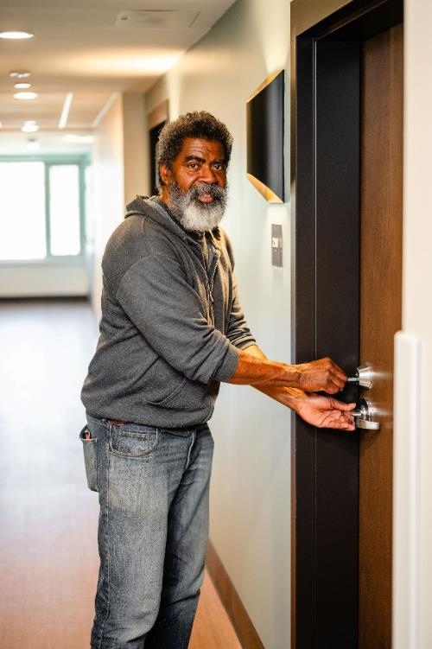
Mission Statement
We are committed to ending and preventing homelessness across Southern MA with programs that shelter and connect people to housing, jobs and services.
We help people who are struggling with homelessness or are at risk of homelessness achieve self-sufficiency.

Slide 18
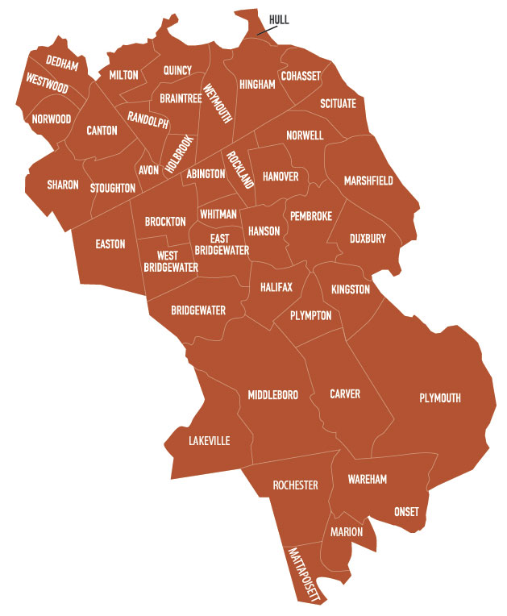
Service Area
41 cities & towns across Southern MA
5,000+ people served annually
*For Tenancy Preservation Program only: Attleboro, Cape Cod & Islands, Fall River, New Bedford, Taunton.

Slide 19
Program and Budget Overview
FY24 operating budget - $40.6M
HUD CPD funds;
CDBG funds from 3 municipalities ~ $50k for shelter operations and services
ESG funds from the 2 local ESG recipients~ $340k for shelter operations and street outreach
HOME funds from state and local municipalities in support of PSH
$1.7M annually in Medicaid funding for specialized community supports for homeless individuals and households at risk of homelessness
Service Continuum:
Homelessness prevention and shelter diversion
Emergency shelter - 300 individuals nightly; 161 families nightly
Street outreach
Employment services
Rapid rehousing
Permanent Supportive Housing – 700+ units

Slide 20
Our Bold Vision Forward: Housing Resource Center Model
Move beyond the limitations of the existing shelter model for those experiencing homelessness and create a new service-delivery model focused on prevention, triage and assessment, and rehousing as quickly as possible with supports.
Develop a day center facility for individuals that is designed expressly to support this purpose.
Reduce reliance on emergency shelter and increase focus on addressing the immediate causes of homelessness.

Slide 21
Our Bold Vision: Housing Resource Center Model
SERVICES
Housing supports
Case management
Health care
Community lunch
Employment services
Partner resources, including behavioral health, addiction and recovery support
DAY CENTER
Full-service medical clinic
Commercial kitchen and dining space
Library/Access to technology
Private meeting space and training rooms
Showers, laundry and lockers
Housing Resource Center sites also offer emergency shelter and permanent supportive housing (30 units in Quincy, 32 units in Brockton)

Slide 22
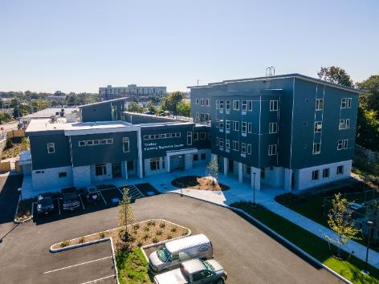
Yawkey Housing Resource Center
Opened in November 2023

Slide 23
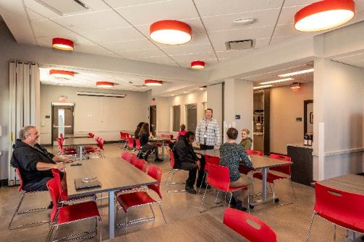
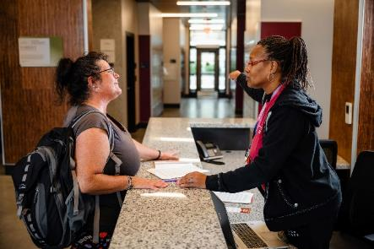
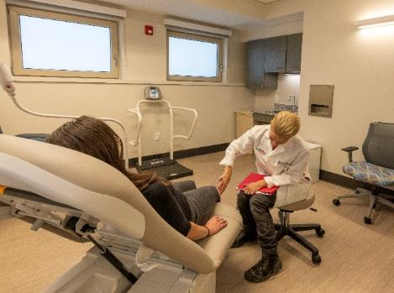
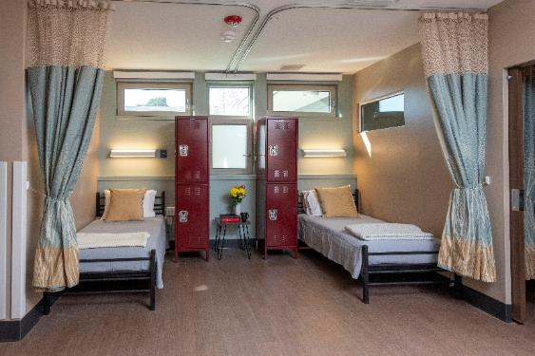
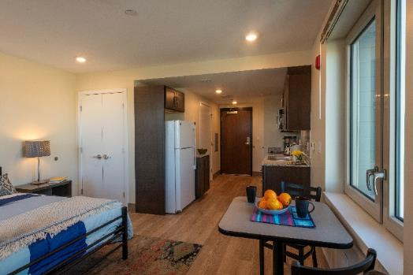
Yawkey Housing Resource Center
Opened in November 2023

Slide 24
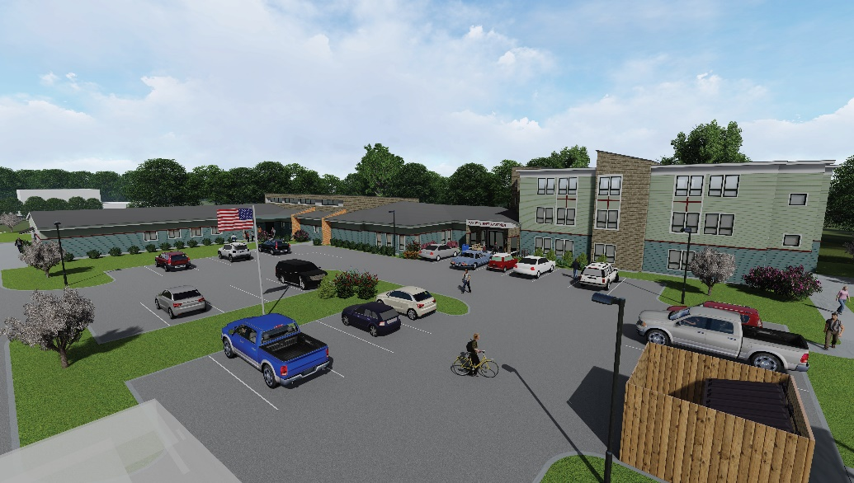
Brockton Housing Resource Center
Coming in 2024/2025

Slide 25
South Shore Continuum of Care
Regional Network to End Homelessness
$10.8M ARD
150+ members: diverse stakeholders working toward a shared agenda to prevent and end homelessness in the region
City of Quincy is collaborative applicant with FBMS as support entity
Deep history of partnership and dedicated capacity to coordinate the network
Commitment to low threshold services/housing and using data to map resources to need

Slide 27
Salt Lake City’s HEART Team
Tony Milner - Director, Housing Stability Division of the Salt Lake City Corp.
HEART is Salt Lake City’s Homeless Engagement and Response Team, which facilitates and coordinates the homelessness-related communication, reporting, data, services, and resources of the city’s many departments.
Additionally, the HEART Team coordinates homelessness-related community partners and regional planning groups to leverage resources and align city responses with community-wide goals.

Slide 28
Questions?

